Slide 1
《生物医学统计学》讨论课
齐光耀
gyqi@ion.ac.cn
2019年4月10日

Slide 2
Outline
Base R and RStudio introduction
Notation
Homework review
Class discussion
Class feedback
Notes:
https://github.com/guhjy/cheatsheets
https://www.rstudio.com/resources/cheatsheets/

Slide 3
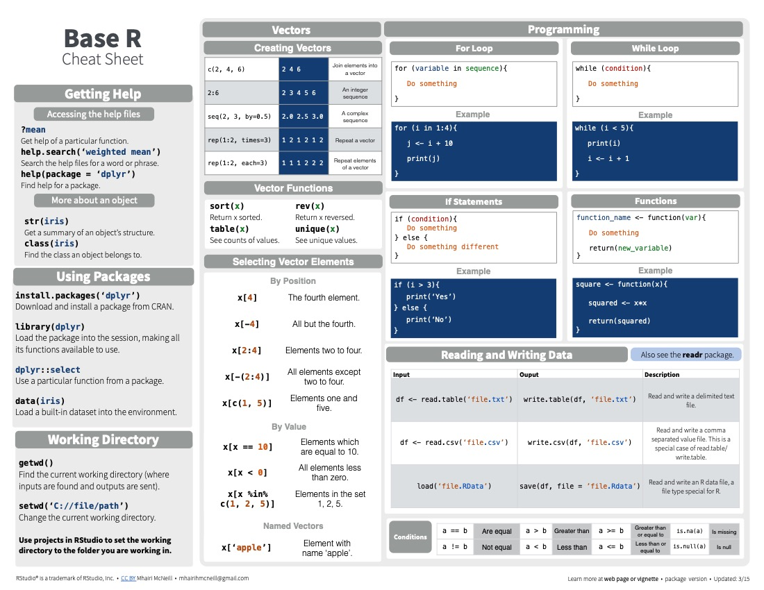
https://www.rstudio.com/resources/cheatsheets/
https://github.com/rstudio/cheatsheets

Slide 4
Rstudio introduction
Take control of your R code
RStudio is an integrated development environment (IDE) for R. It includes a console, syntax-highlighting editor that supports direct code execution, as well as tools for plotting, history, debugging and workspace management.
RStudio is available in open source and commercial editions and runs on the desktop (Windows, Mac, and Linux) or in a browser connected to RStudio Server or RStudio Server Pro (Debian/Ubuntu, RedHat/CentOS, and SUSE Linux).
https://www.rstudio.com

Slide 5




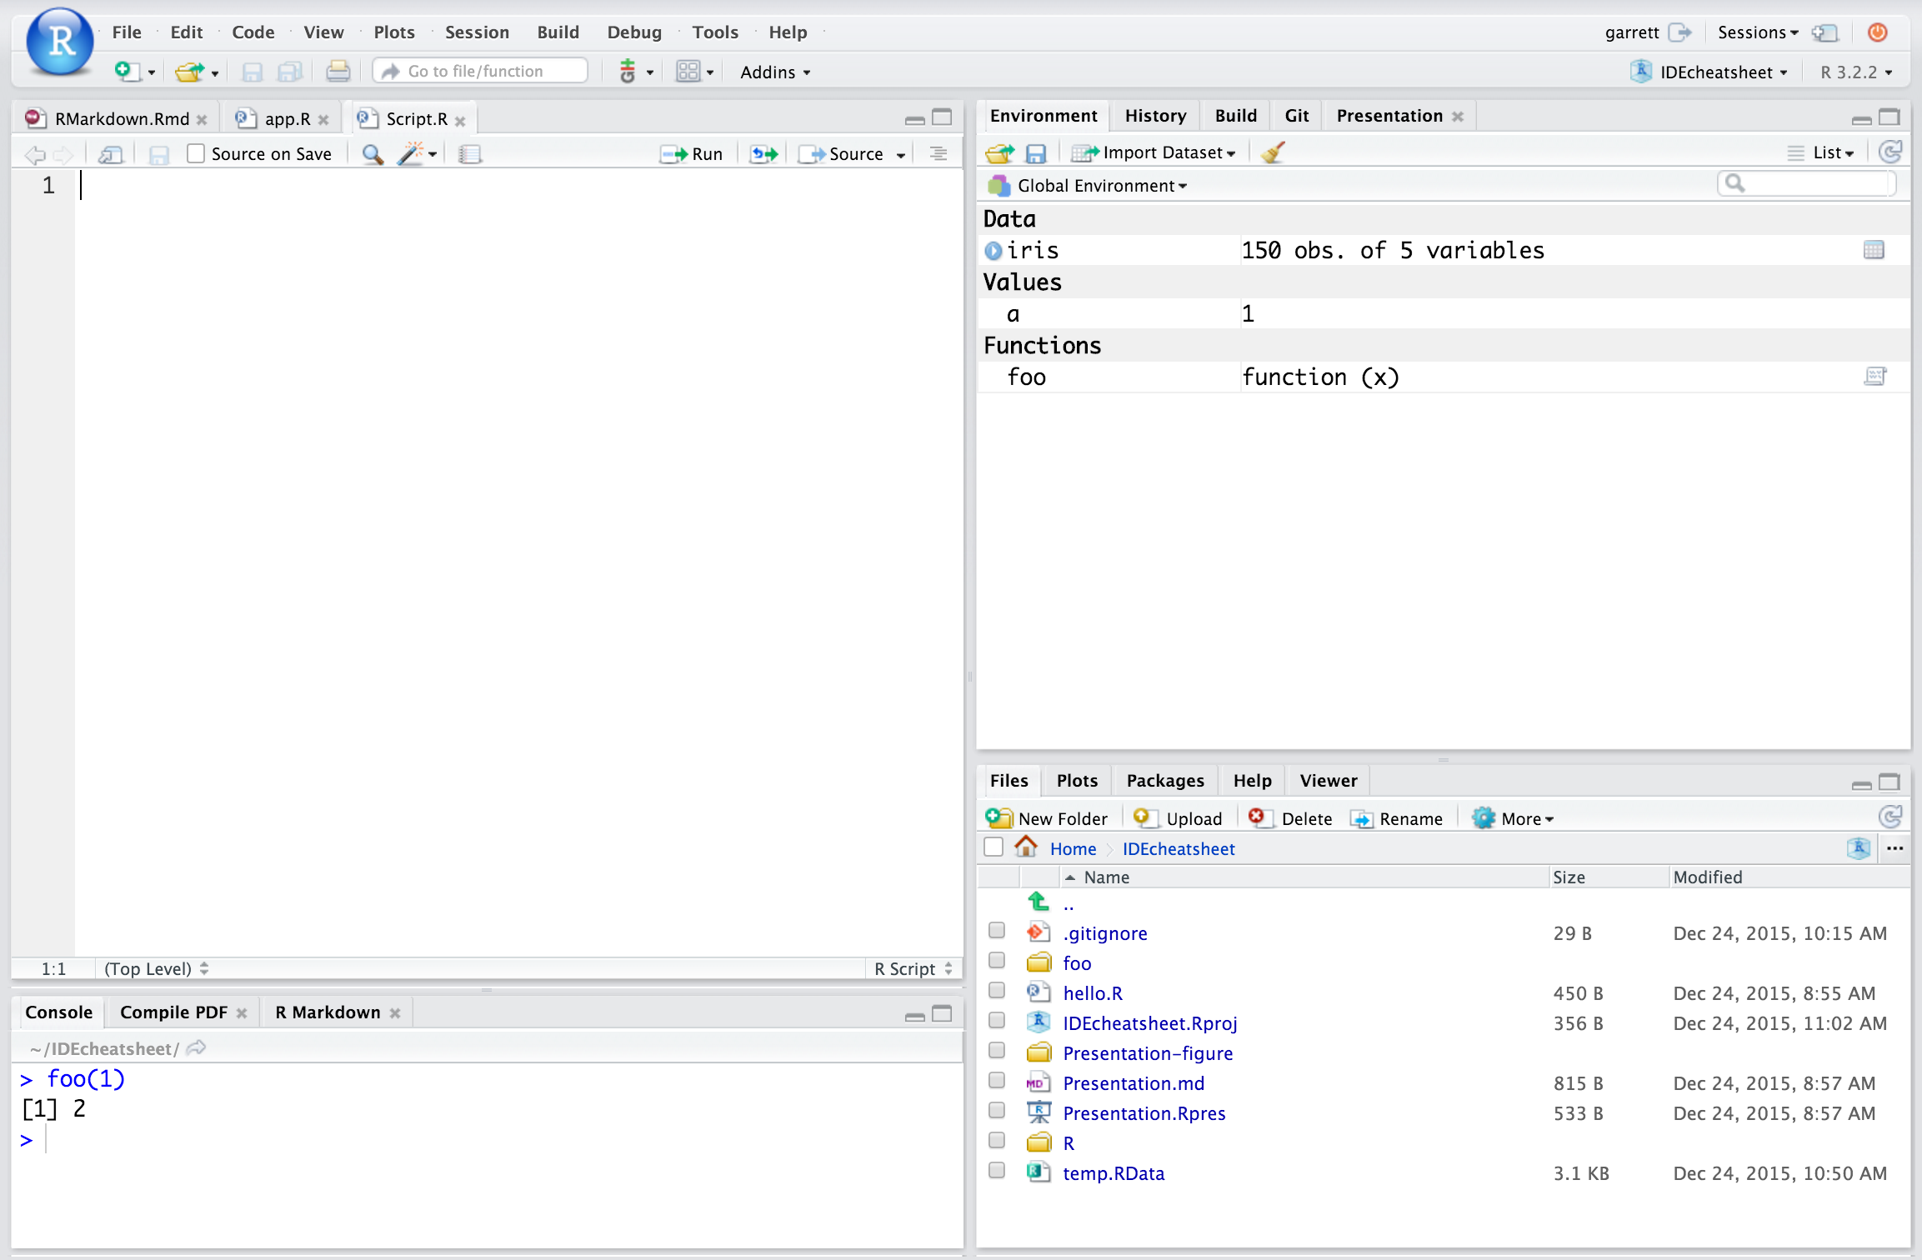
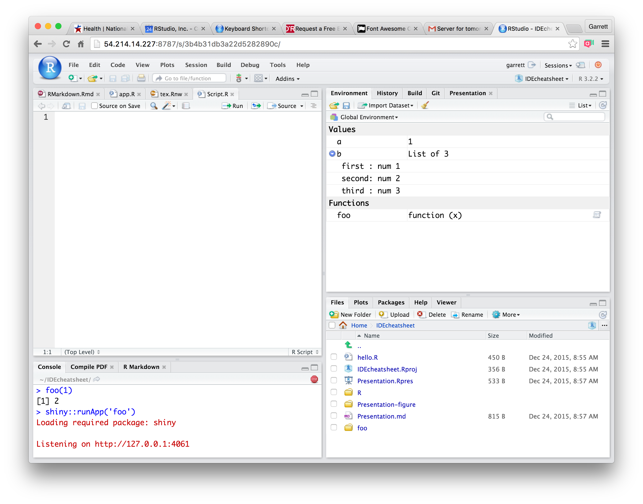
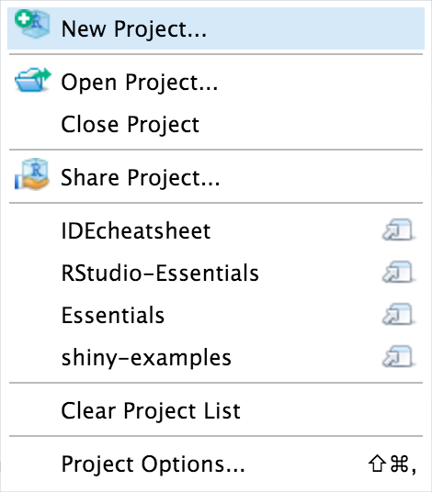
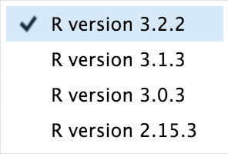
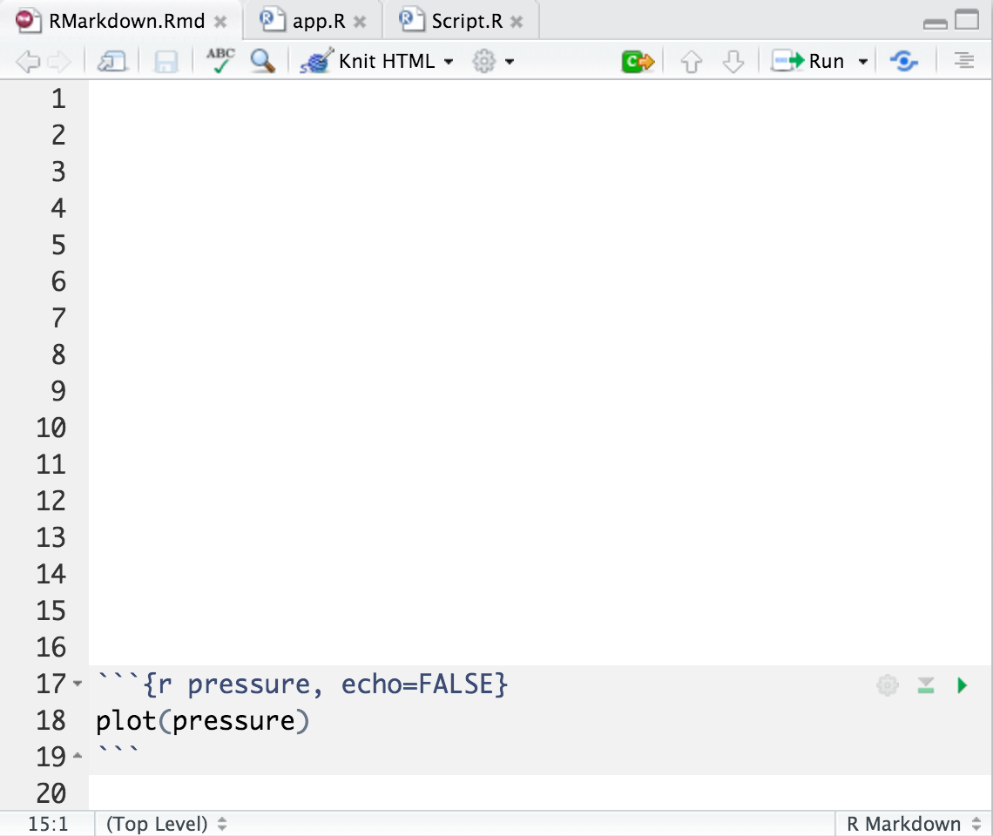
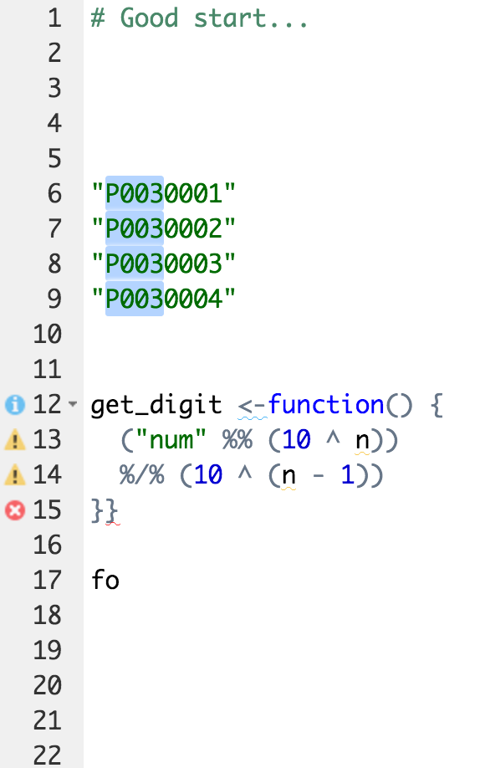
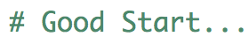
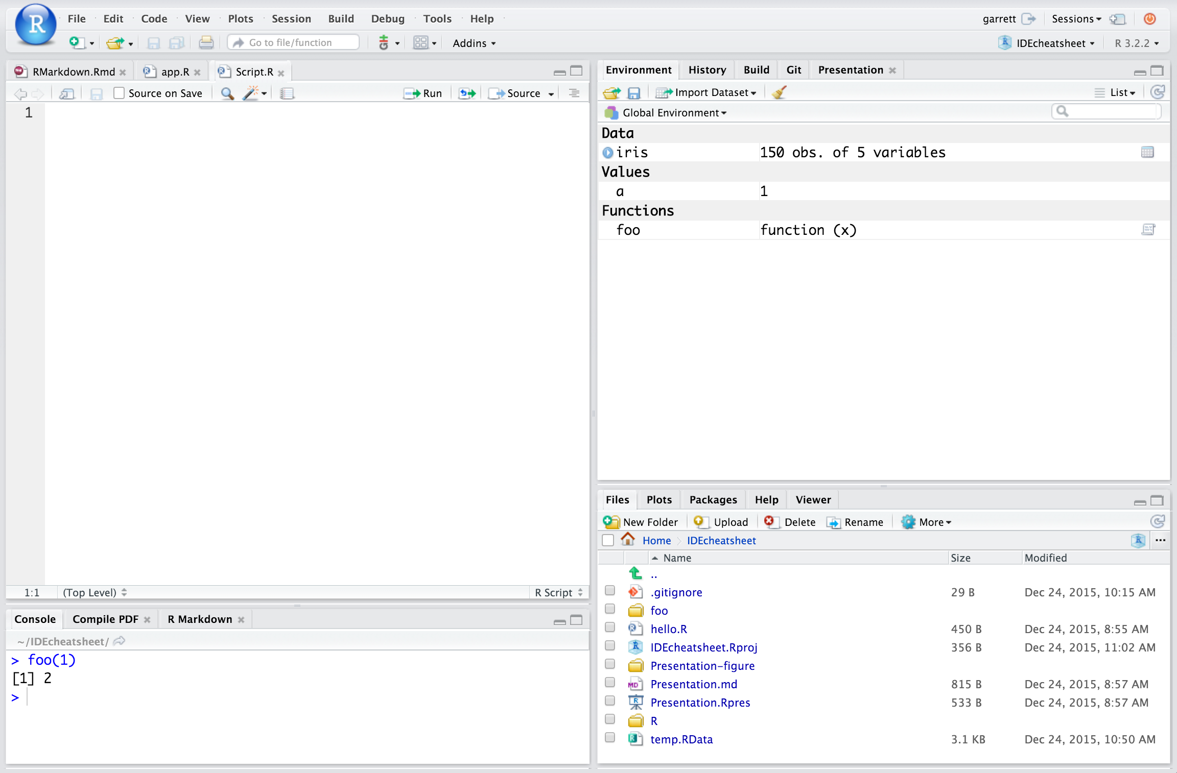
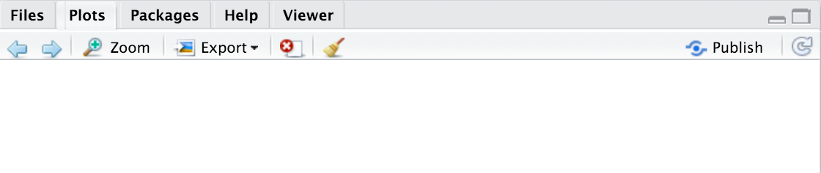
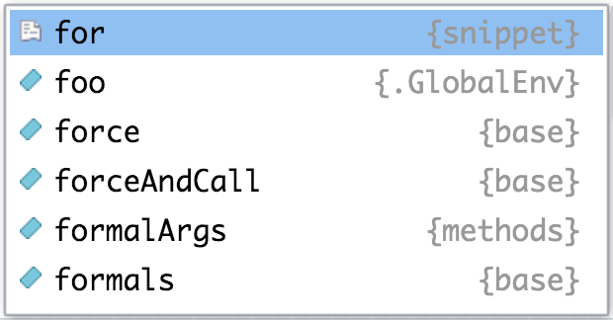
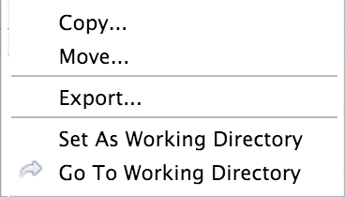
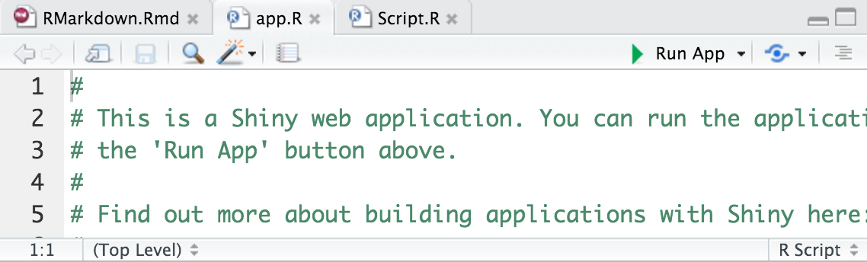
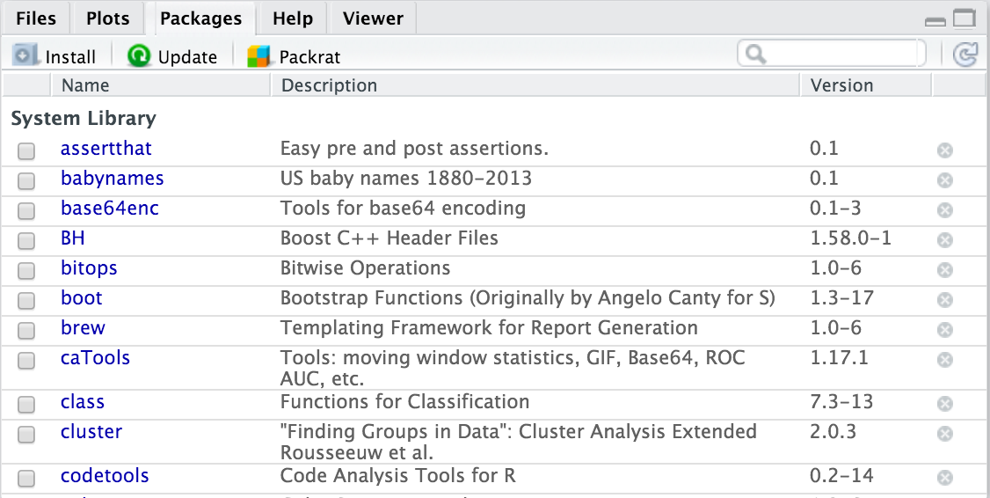
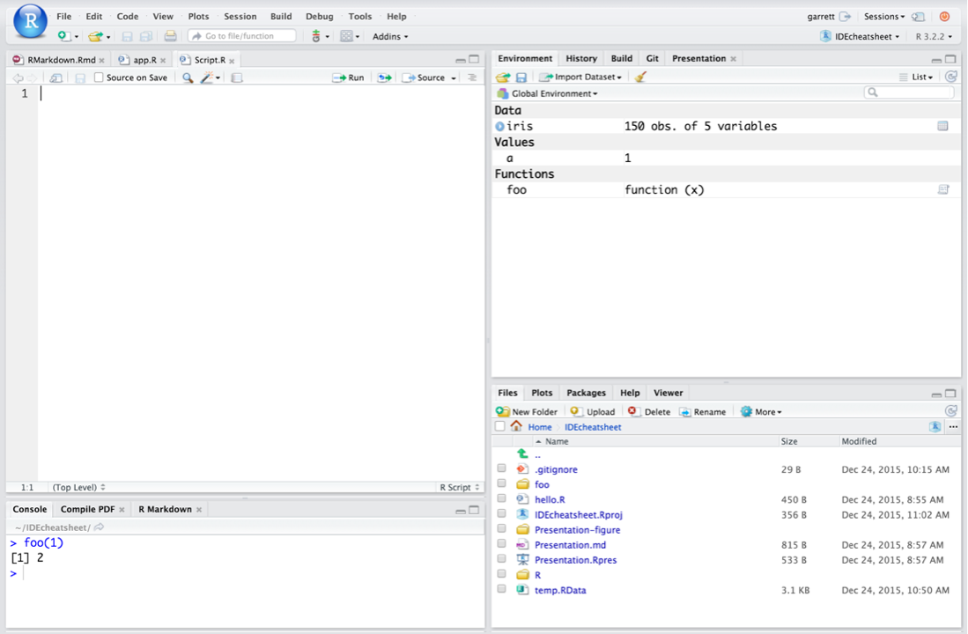

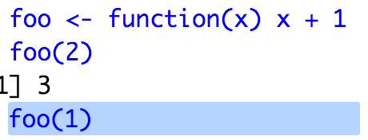

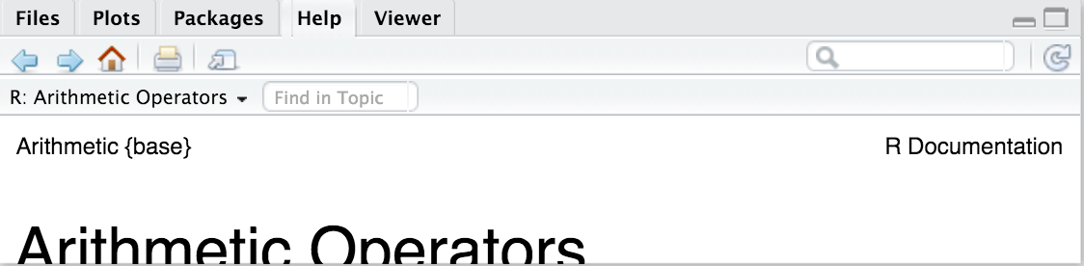
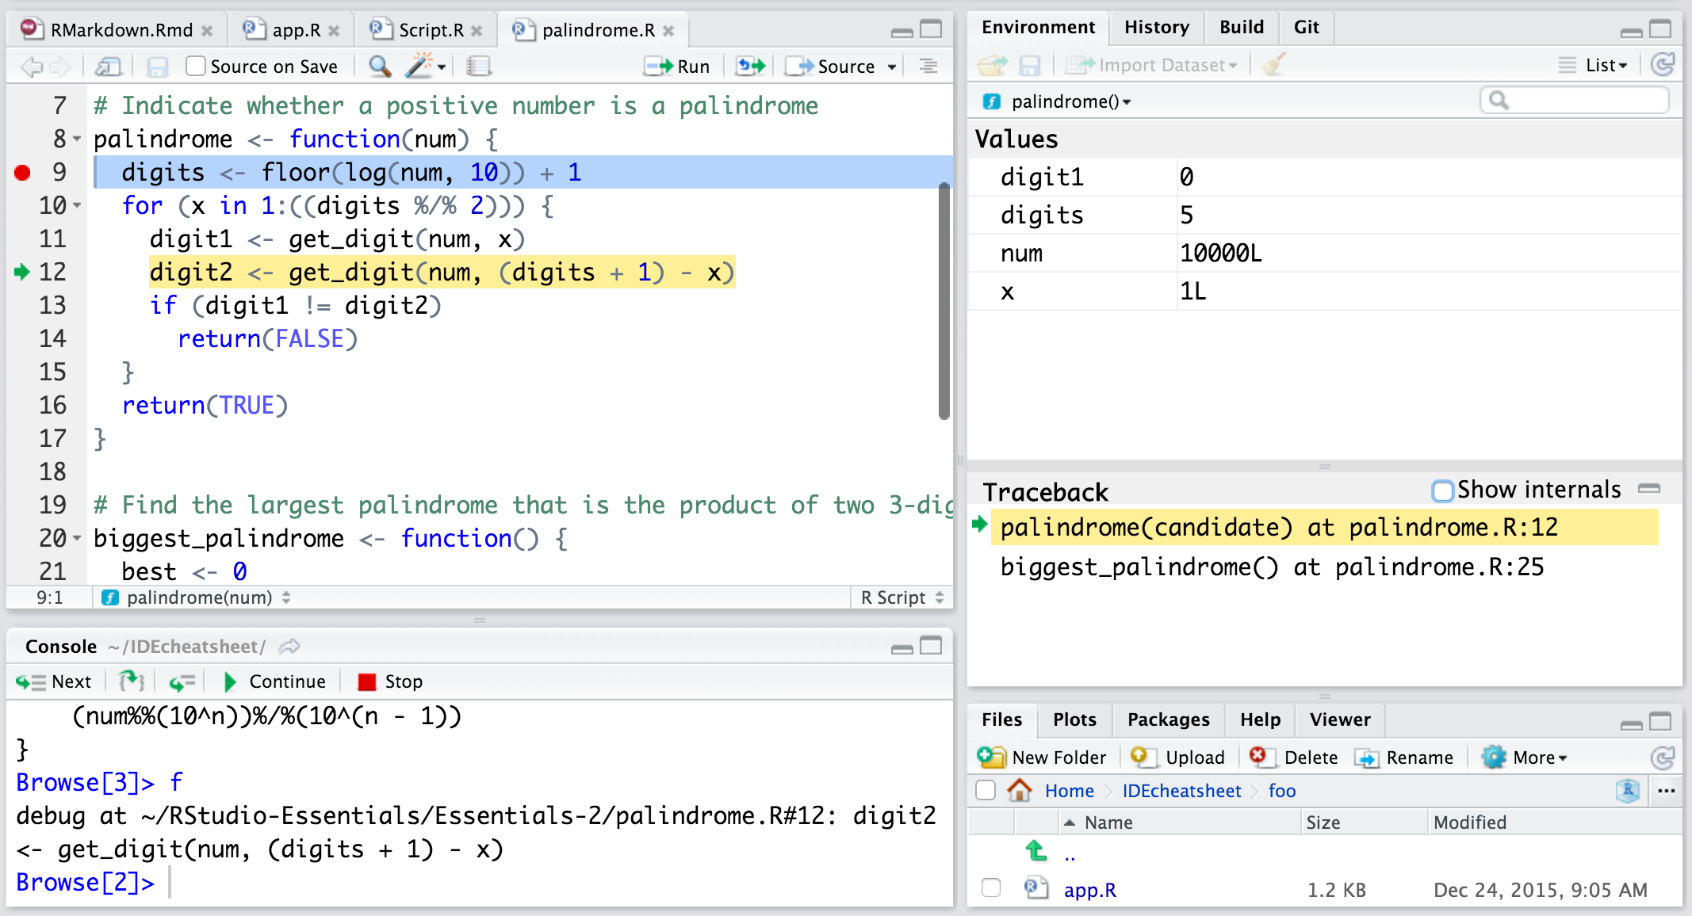
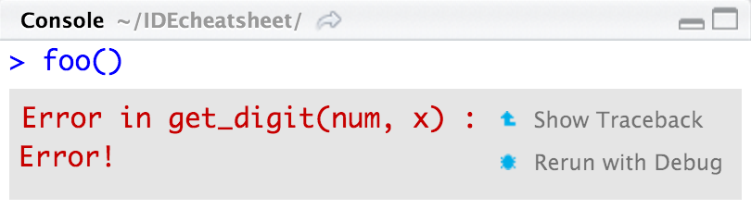
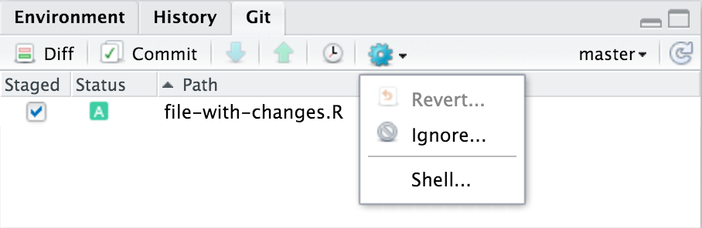
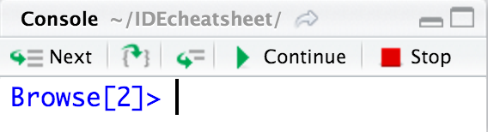
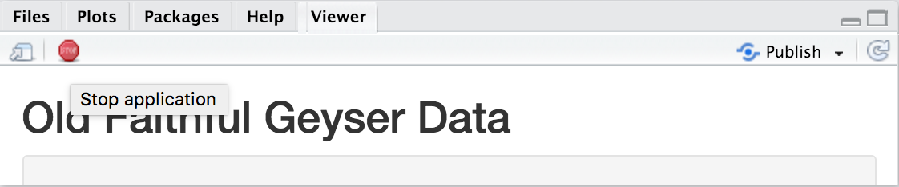
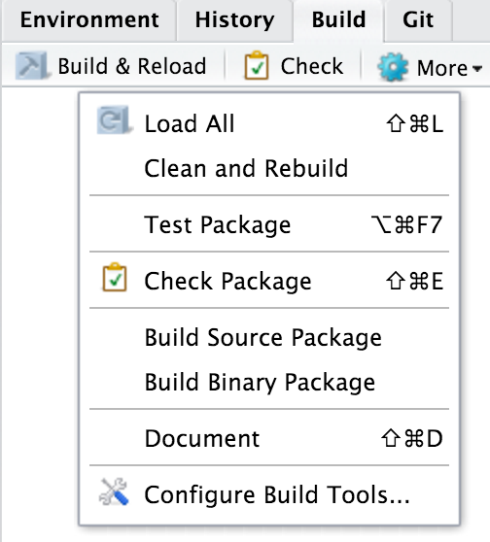
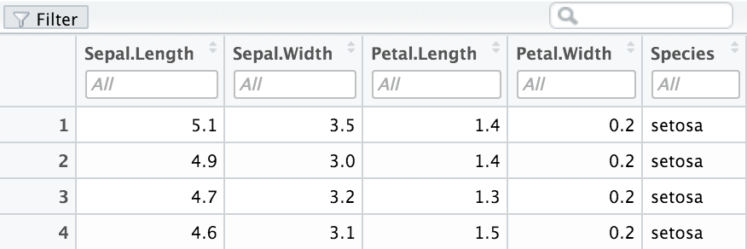

RStudio IDE : : CHEAT SHEET
Documents and Apps
Write Code
R Support
Pro Features
Open Shiny, R Markdown, knitr, Sweave, LaTeX, .Rd files and more in Source Pane
Navigate tabs
Open in new window
Save
Find and replace
Compile as notebook
Run selected code
Import data with wizard
History of past commands to run/copy
Display .RPres slideshows
File > New File >
R Presentation
Share Project with Collaborators
Active shared collaborators
Start new R Session in current project
Check spelling
Render output
Choose output format
Choose output location
Insert code chunk
T
H
J
T
H
J
Close R Session in project
Cursors of shared users
Re-run previous code
Source with or without Echo
Show file outline
Load workspace
Save workspace
Delete all saved objects
Search inside environment
Select
R Version
Jump to previous chunk
Jump to next chunk
Run selected lines
Publish to server
Show file outline
Multiple cursors/column selection with Alt + mouse drag.
Choose environment to display from list of parent environments
Display objects as list or grid
PROJECT SYSTEM
File > New Project
Access markdown guide at
Help > Markdown Quick Reference
Code diagnostics that appear in the margin. Hover over diagnostic symbols for details.
RStudio saves the call history, workspace, and working directory associated with a project. It reloads each when you re-open a project.
Jump to chunk
Set knitr chunk options
Run this and all previous code chunks
Run this code chunk
Syntax highlighting based on your file's extension
Name of current project
Tab completion to finish function names, file paths, arguments, and more.
Displays saved objects by type with short description
View in data viewer
View function source code
RStudio opens plots in a dedicated Plots pane
Multi-language code snippets to quickly use common blocks of code.
Navigate recent plots
Open in window
Export plot
Delete plot
Delete all plots
RStudio recognizes that files named app.R, server.R, ui.R, and global.R belong to a shiny app
Jump to function in file
Change file type
GUI Package manager lists every installed package
Create folder
Upload file
Delete file
Rename file
Change directory
Run app
Choose location to view app
Publish to shinyapps.io or server
Manage publish accounts
Path to displayed directory
Install Packages
Update Packages
Create reproducible package library for your project
Working Directory
Maximize, minimize panes
Press  to see command history
Drag pane boundaries
A File browser keyed to your working directory. Click on file or directory name to open.
Click to load package with library(). Unclick to detach package with detach()
Package version installed
Delete from library
Debug Mode
Version Control with Git or SVN
RStudio opens documentation in a dedicated Help pane
Open with debug(), browser(), or a breakpoint. RStudio will open the debugger mode when it encounters a breakpoint while executing code.
Launch debugger mode from origin of error
Open traceback to examine the functions that R called before the error occurred
Turn on at Tools > Project Options > Git/SVN
Stage files:
Show file diff
Commit staged files
Push/Pull to remote
View History
Click next to line number to add/remove a breakpoint.
Added
Deleted
Modified
Renamed
Untracked
Home page of helpful links
Search within help file
Search for help file
A
D
Viewer Pane displays HTML content, such as Shiny apps, RMarkdown reports, and interactive visualizations
M
Open shell to type commands
current branch
R
Highlighted line shows where execution has paused
?
Package Writing
Stop Shiny app
Publish to shinyapps.io, rpubs, RSConnect, …
Refresh
File > New Project >
New Directory > R Package
View(<data>) opens spreadsheet like view of data set
Run commands in environment where execution has paused
Examine variables in executing environment
Select function in traceback to debug
Step through code one line at a time
Step into and out of functions to run
Resume execution
Quit debug mode
Turn project into package,
Enable roxygen documentation with
Tools > Project Options > Build Tools
Roxygen guide at
Help > Roxygen Quick Reference
Filter rows by value or value range
Sort by values
Search for value
RStudio® is a trademark of RStudio, Inc. • CC BY SA RStudio • info@rstudio.com • 844-448-1212 • rstudio.com • Learn more at www.rstudio.com • RStudio IDE 0.99.832 • Updated: 2016-01

Slide 6
Notation
匈牙利命名法
在匈牙利命名法中，一个变量名由一个或多个小写字母开始，这些字母有助于记忆变量的类型和用途，紧跟着的就是程序设计师选择的任何名称。这个后半部分的首字母可以大写，以区别前面的类型指示字母。
基本原则是：变量名=属性+类型+对象描述。如i表示int，所有i开头的变量命都表示int类型。s表示String，所有变量命以s开头的都表示String类型变量。
lAccountNum：变量是一个长整数（"l"）
骆驼命名法
当变量名和函数名称是由二个或多个单字链接在一起，而构成的唯一识别字时，利用“驼峰式大小写”来表示，可以增加变量和函数的可读性。
小驼峰式命名法（lower camel case）：第一个单字以小写字母开始；第二个单字的首字母大写，例如：firstName、lastName。
大驼峰式命名法（upper camel case）：每一个单字的首字母都采用大写字母，例如：FirstName、LastName、CamelCase，也被称为Pascal命名法（英语：Pascal Case）
其他相关格式
StudlyCaps是指大小写混用且不使用空格、连接号或下划线的格式，如sTuDlyCAps。StudlyCaps可以视为“驼峰式大小写”的变种。
Notes:
cnblogs.com/guanghe/p/5559372.html

Slide 7
Homework review
6、已知某校2万人体检测得所有人的平均体重为59kg，标准差为25kg，从中抽取20人的样本体重值如下表所示：
样品编号 | 体重(kg)
1 | 61.5
2 | 54
3 | 60.5
4 | 54.5
5 | 52.5
6 | 67.5
7 | 63
8 | 57.5
9 | 65.5
10 | 58
11 | 60
12 | 70
13 | 53
14 | 64
15 | 56
16 | 66
17 | 70.5
18 | 57.5
19 | 49
20 | 59.5
(1) 求置信区间95%时的边际误差E？(8')
(2) 求样本均值落在50~63kg之间的概率？(8')
(3) 求样本均值95%的置信区间？(8')

Slide 8
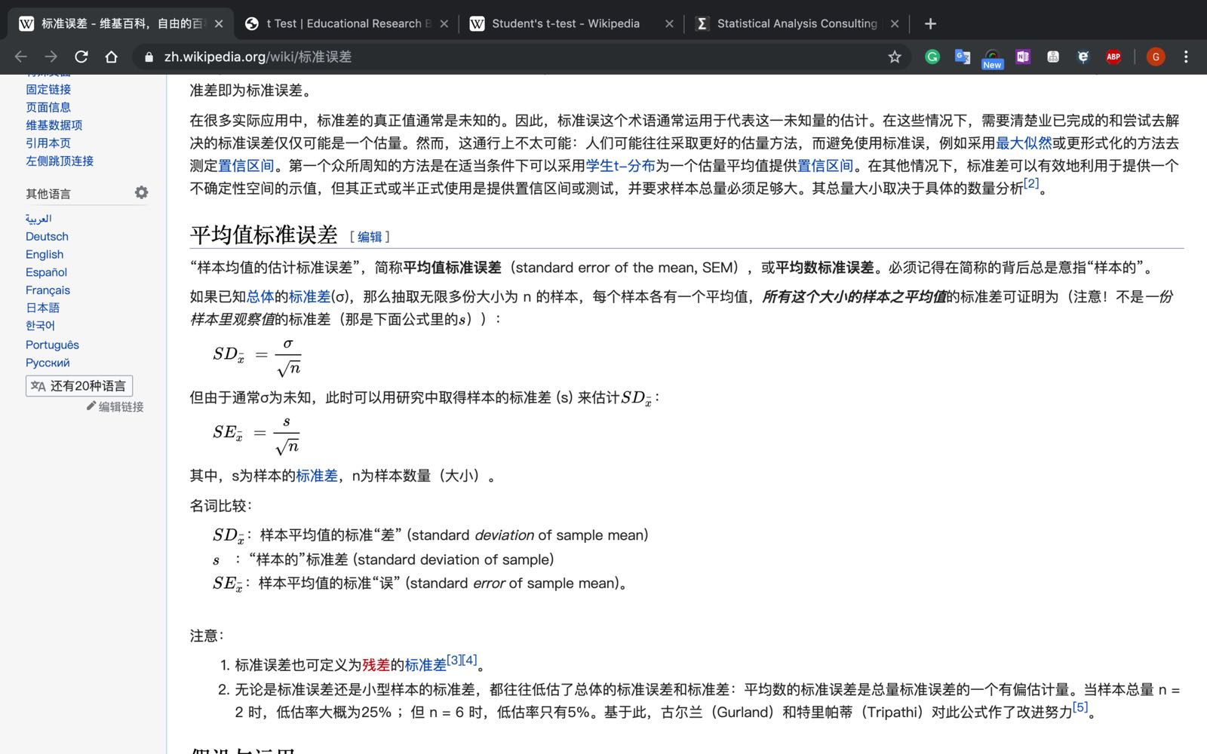
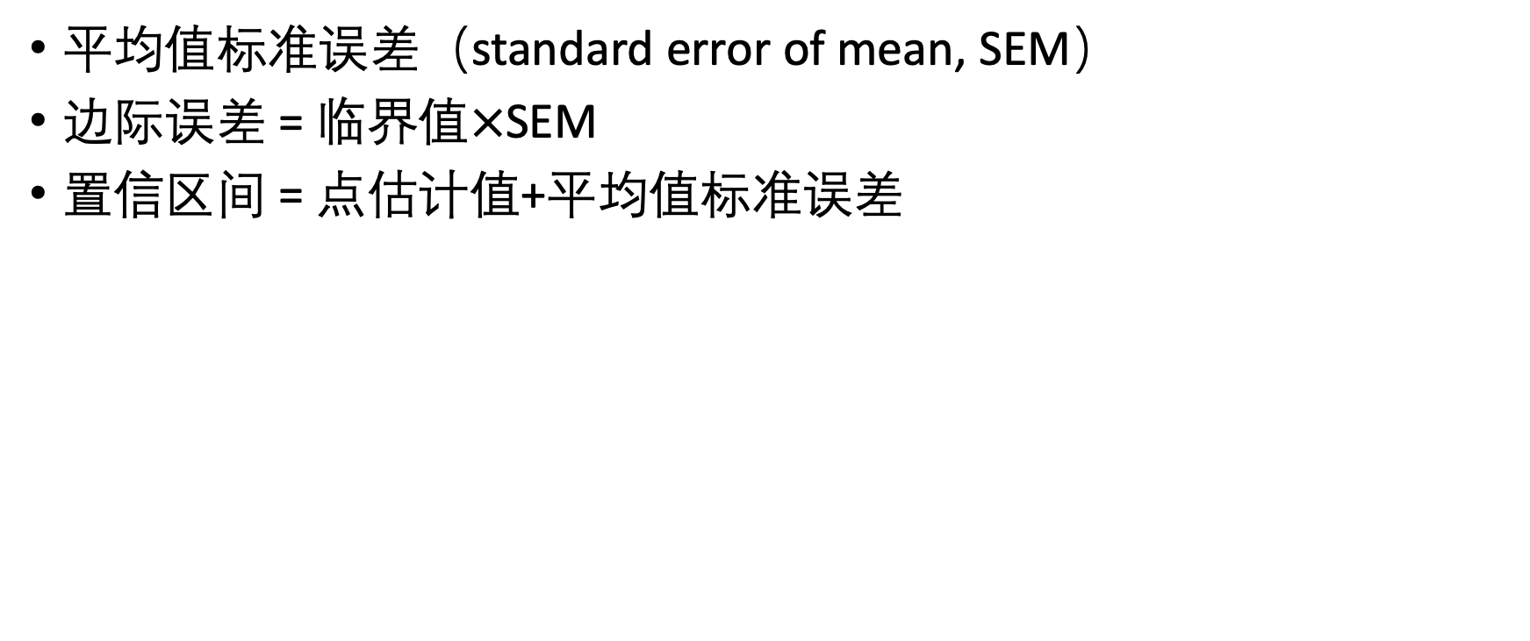
Homework review
平均值标准误差（standard error of mean, SEM）
边际误差 = 临界值$×$SEM
置信区间 = 点估计值+平均值标准误差

Slide 9
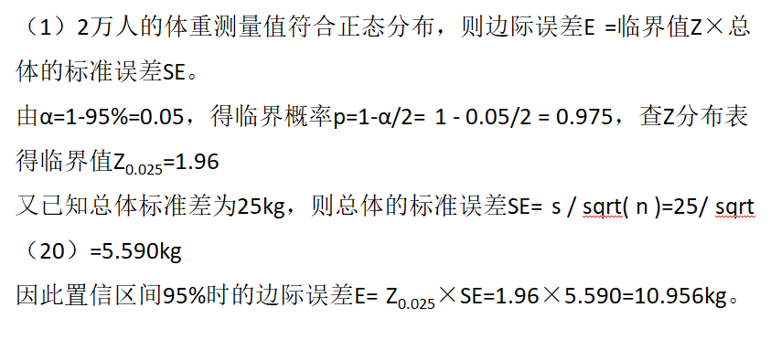
Homework review

Slide 10
Class discussion
15 min

Slide 14
Class feedback

